Slide 1
Wavelet EMP User Guide
Created on 2 July 2014

Slide 2
Contents
Category | Category 2 | Category 3 | Page #
1.0 Master Data Management | 1.1 Organization Master | 1.1a Create Company
 |  | 1.1b Edit Company
 |  | 1.1c Create Cashbook
 |  | 1.1d Create Location
 |  | 1.1e Create Branch
 | 1.2 Customer Master | 1.2a Create New Customer
 |  | 1.2b Add Customer contact person
 |  | 1.2c Generate Customer List
 | 1.3 Item Master | 1.3a Create New Item
 |  | 1.3b Generate Item List
 | 1.4 Supplier Master | 1.4a Create Supplier
 |  | 1.4b Generate Supplier List
 | 1.5 User Master | 1.5a Create New User
 |  | 1.5b Create New Role
 |  | 1.5c Edit Role
 |  | 1.5d Generate User List
 |  | 1.5e Configure Role Permissions

Slide 3
Contents
Category | Category 2 | Category 3 | Page #
2.0 Sales Order Management | 2.1 Create Sales Order
 | 2.2 Scan IMEI into Sales Order
 | 2.3 Convert Sales to Invoice
 | 2.4 Sales Return by Invoice
3.0 Purchase Order Management | 3.1 Create Purchase Order
 | 3.2 Goods Receive Note by Purchase Order
 | 3.3 Purchase Return by Goods Receive Note
4.0 Inventory Management | 4.1 Create Stock Requisition
 | 4.2 Create Stock Transfer | 4.2a Create Internal Stock Transfer
 |  | 4.2b Generate Stock Transfer Listing
 |  | 4.2c Generate Detailed Stock Transfer
 |  | 4.2d Receive Stock Transfer
 |  | 4.2 e Cancel Stock Transfer
 | 4.3 Create Stock Adjustment

Slide 4
Contents
Category | Category 2 | Category 3 | Page #
5.0 Finance | 5.1 Customer Aging | 5.1a Monitor Customer Outstanding Invoices
 |  | 5.1b Print Customer Statement of Account
 | 5.2 Account Receivable | 5.2a Receive Customer Payment
 | 5.3 Account Payable | 5.3a Monitor Supplier Outstanding Invoice
 |  | 5.3b Issue Payment to Supplier

Slide 5
1.0 Master Data Management
1.1 Organization Master
1.2 Customer Master
1.3 Item Master
1.4 Supplier Master
1.5 User Master

Slide 6
1.0 Master Data Management
1.1 Organization Master
1.1a Create Company
1.1b Edit Company
1.1c Create Cash Book
1.1d Create Branch
1.1e Create Location
1.2 Customer Master
1.3 Item Master
1.4 Supplier Master
1.5 User Master

Slide 7
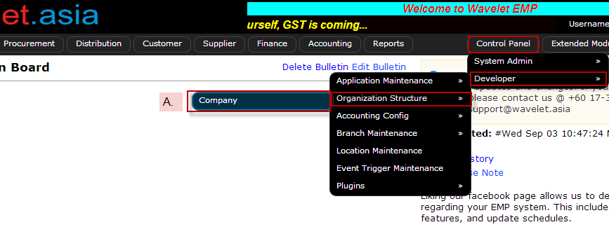
1.0 Master Data Management
1.1 Organization Master
1.1a Create Company
1.1b Edit Company
1.1c Create Cash Book
1.1d Create Branch
1.1e Create Location
Description | Screenshot
1.1a Create Company Set up of your company’s details on ERP System. Go to [Control Panel >Developer > Organization Structure > Company]

Slide 8
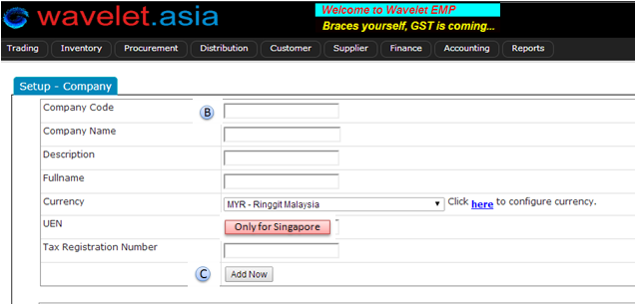
1.0 Master Data Management
1.1 Organization Master
1.1a Create Company
1.1b Edit Company
1.1c Create Cash Book
1.1d Create Branch
1.1e Create Location
Description | Screenshot
B. Input the following details: Examples: Company Code: ABC Company Name: ABC SDN BHD Description: Full Name: UEN: [Not used for Malaysia] Tax Reg.Number: C. Click [Add Now]

Slide 9
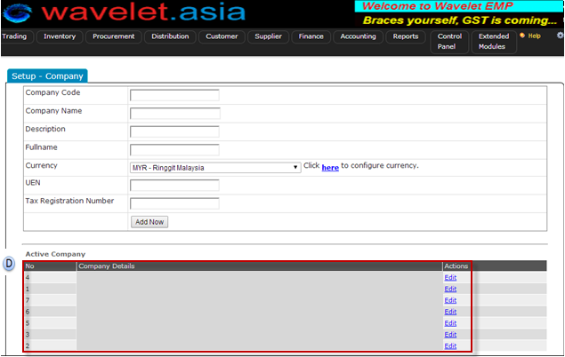
1.0 Master Data Management
1.1 Organization Master
1.1a Create Company
1.1b Edit Company
1.1c Create Cash Book
1.1d Create Branch
1.1e Create Location
Description | Screenshot
D. Once company has been successfully created, it will appear here.

Slide 10
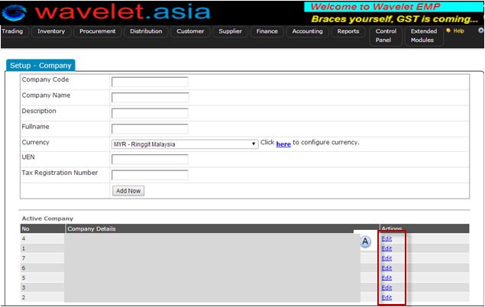
1.0 Master Data Management
1.1 Organization Master
1.1a Create Company
1.1b Edit Company
1.1c Create Cash Book
1.1d Create Branch
1.1e Create Location
Description | Screenshot
1.1b Edit Company To change/update details of existing registered companies. Go to: Control Panel >Developer > Organization Structure > Company A. Click [EDIT] on the company to be edited.

Slide 11
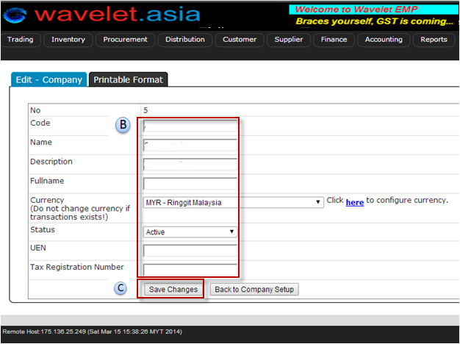
1.0 Master Data Management
1.1 Organization Master
1.1a Create Company
1.1b Edit Company
1.1c Create Cash Book
1.1d Create Branch
1.1e Create Location
Description | Screenshot
B. Input the details requiring update. C. Click [Save Changes] when completed.

Slide 12
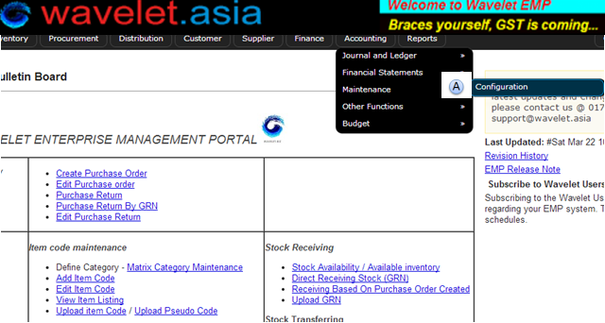
1.0 Master Data Management
1.1 Organization Master
1.1a Create Company
1.1b Edit Company
1.1c Create Cash Book
1.1d Create Branch
1.1e Create Location
Description | Screenshot
1.1c Create Cash Book Cashbook manages and records incoming and outgoing cash transactions A. Go to: [Accounting> Maintenance> Configuration]

Slide 13
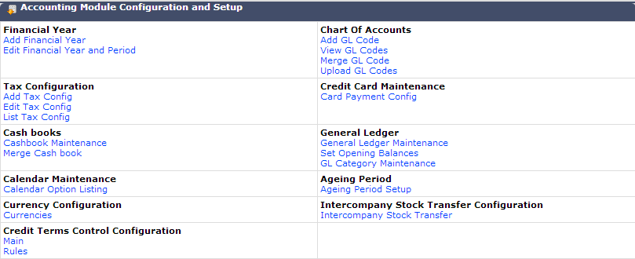
1.0 Master Data Management
1.1 Organization Master
1.1a Create Company
1.1b Edit Company
1.1c Create Cash Book
1.1d Create Branch
1.1e Create Location
Description | Screenshot
B. Click [Cashbook Maintenance]
B

Slide 14
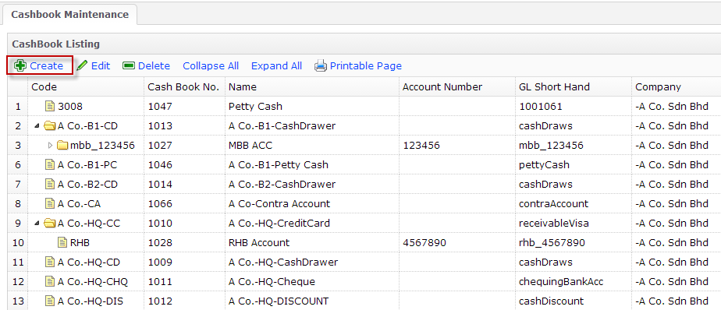
1.0 Master Data Management
1.1 Organization Master
1.1a Create Company
1.1b Edit Company
1.1c Create Cash Book
1.1d Create Branch
1.1e Create Location
Description | Screenshot
C. Click [Create]
C

Slide 15
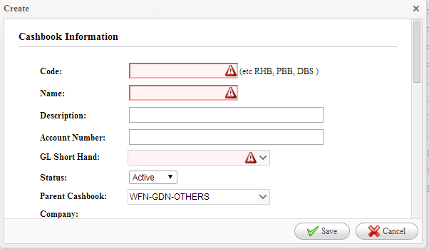
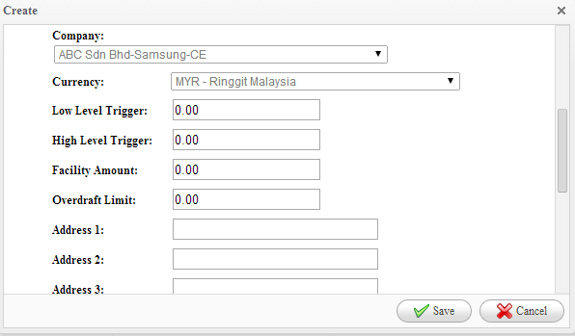
1.0 Master Data Management
1.1 Organization Master
1.1a Create Company
1.1b Edit Company
1.1c Create Cash Book
1.1d Create Branch
1.1e Create Location
Description | Screenshot
D. Fill in the compulsory details Example Code: ABC-CD Name: ABC Cash Drawer GL Shorthand: cashDraw (select from dropdown list / key in key word) E. Select which company to tag Cashbook from dropdown list F. Click [Save] to complete cashbook creation
D
D
E
F

Slide 16
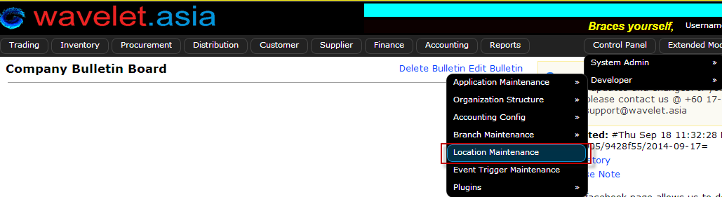
1.0 Master Data Management
1.1 Organization Master
1.1a Create Company
1.1b Edit Company
1.1c Create Cash Book
1.1d Create Location
1.1e Create Branch
Description | Screenshot
1.1e Create Location Structure warehouses as physical or virtual inventory locations according to needs. A. Go to: [Control Panel> Developer> Location Maintenance]
A

Slide 17
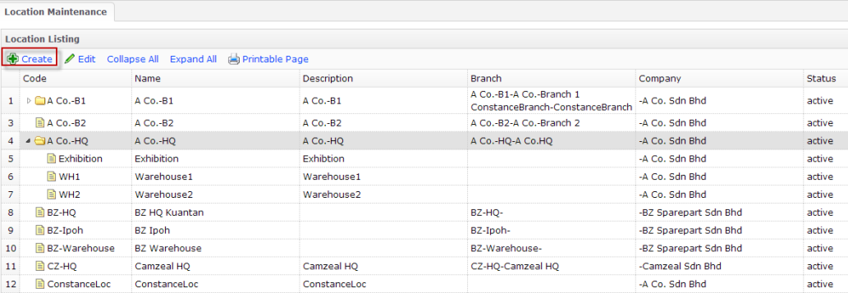
1.0 Master Data Management
1.1 Organization Master
1.1a Create Company
1.1b Edit Company
1.1c Create Cash Book
1.1d Create Location
1.1e Create Branch
Description | Screenshot
B. Click [Create]
B
Example

Slide 18
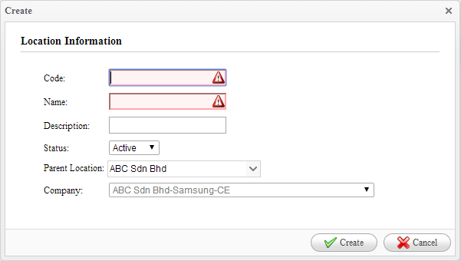
1.0 Master Data Management
1.1 Organization Master
1.1a Create Company
1.1b Edit Company
1.1c Create Cash Book
1.1d Create Location
1.1e Create Branch
Description | Screenshot
C. Fill in compulsory fields: Example 1 Code: ABC Ampang Name: ABC Ampang Warehouse Example 2 Code: ABC RMA Name: ABC RMA Virtual Example 3 Code: ABC Defect Name: ABC Defect Virtual D. Select Parent Location from drop down list (Optional) E. Click [Create] to complete
C
D
E

Slide 19
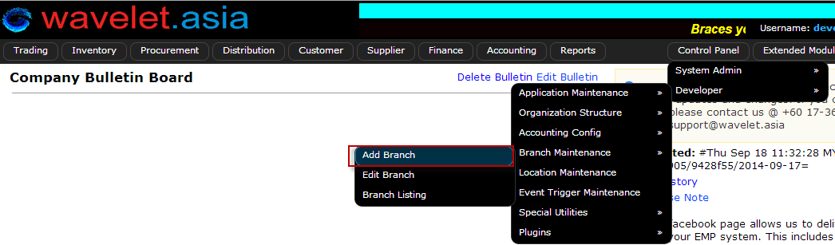
1.0 Master Data Management
1.1 Organization Master
1.1a Create Company
1.1b Edit Company
1.1c Create Cash Book
1.1d Create Location
1.1e Create Branch
Description | Screenshot
1.1d Create Branch (only developer user) Generate branches linked to parent company. A. Go to: [Control Panel> Developer> Branch Maintenance> Add Branch]
A

Slide 20
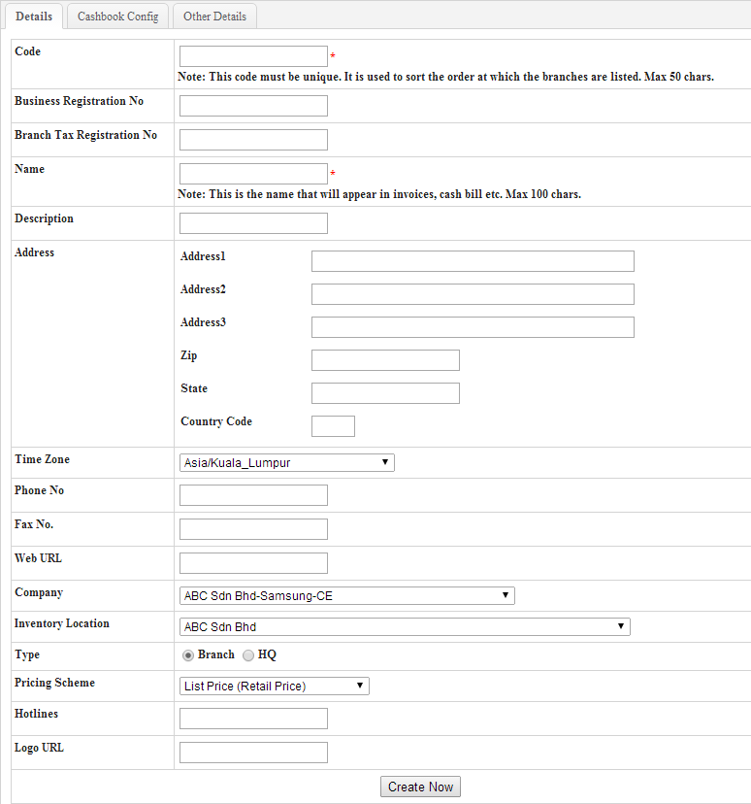
1.0 Master Data Management
1.1 Organization Master
1.1a Create Company
1.1b Edit Company
1.1c Create Cash Book
1.1d Create Location
1.1e Create Branch
Description | Screenshot
B. Fill in the fields: Example Code :ABC HQ (Max 50 Char): (compulsory) Company Name: e.g. ABC Head Quarters (compulsory) Address Phone Number Company: select name of parent company from dropdown list Inventory Location: select from dropdown list. Location set up in 1.1d C. Select type: Branch/HQ D. Click [Create Now] to complete
B
B
B
C
D

Slide 21
1.0 Master Data Management
1.1 Organization Master
1.2 Customer Master
1.2a Create New Customer
1.2b Add Customer Contact Person
1.2c Generate Customer List
1.3 Item Master
1.4 Supplier Master
1.5 User Master

Slide 22
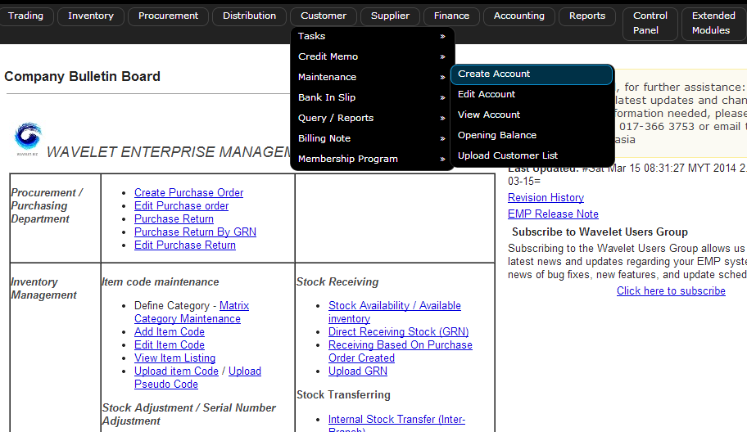
1.0 Master Data Management
1.2 Customer Master
1.2a Create New Customer
1.2b Add Customer Contact Person
1.2c Generate Customer List
Description | Screenshot
1.2a Create New Customer Adding a new customer account A. Go to [Customer> Maintenance> Create Account]
A

Slide 23
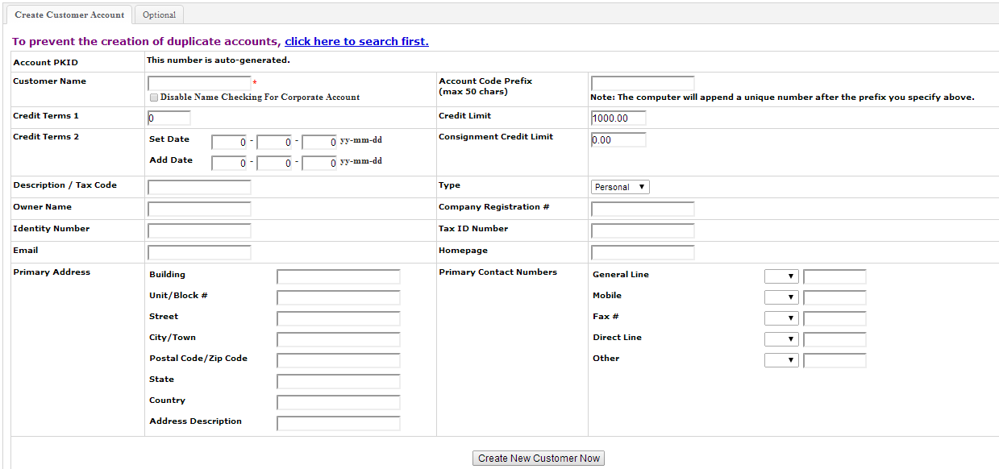
1.0 Master Data Management
1.2 Customer Master
1.2a Create New Customer
1.2b Add Customer Contact Person
1.2c Generate Customer List
Description | Screenshot
B. Key in compulsory customer details Create Customer Account Tab Customer Name: Name of Company Account Code: [optional, refer to old system code) Address Contact Number Credit Terms Credit Terms 1: Number of Days The terms which indicate when payment is due for sales made on account (or credit).This just use for normal credit term and only use for calculate the no of days Credit Terms 2/3/4/5: This can be use as a grace period controlling and some term that got some count both on day and month and etc. Each Credit Terms Set Date (yy,mm,dd)This is use as reset the date of create invoice to certain date Add Date (yy,mm,dd)This is used as the no of date to add on the reset date Eg. Sample usage of SET DATE and ADD DATE : eg1. EOM + 7days SET DATE: 0-0-1 ADD DATE: 0-1-7
B

Slide 24
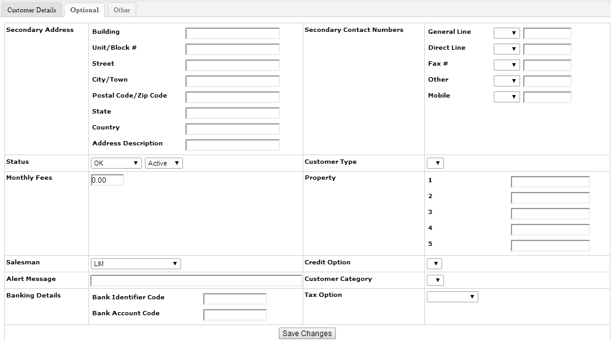
1.0 Master Data Management
1.2 Customer Master
1.2a Create New Customer
1.2b Add Customer Contact Person
1.2c Generate Customer List
Description | Screenshot
(Optional) Additional Customer Details C. Click on [Optional] Tab D. Fill in fields if applicable. E. Link customer to salesman F. Click [Save Changes] to submit
C
D
E
E

Slide 25
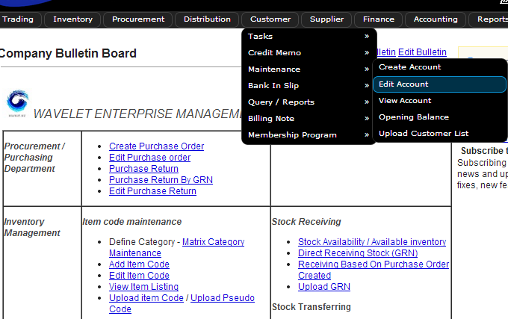
1.0 Master Data Management
1.2 Customer Master
1.2a Create New Customer
1.2b Add Customer Contact Person
1.2c Generate Customer List
Description | Screenshot
1.2b Add Customer Contact Person Contact Person will be used as Ship To destination upon Creating SO / INV A. Go to [Customer> Maintenance> Edit Account]
A

Slide 26
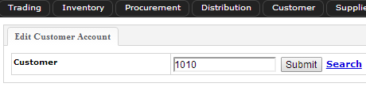
1.0 Master Data Management
1.2 Customer Master
1.2a Create New Customer
1.2b Add Customer Contact Person
1.2c Generate Customer List
Description | Screenshot
Input the customer to be updated Option 1: B. Key in Customer code and click [Submit] Option 2: C. Click [Search] to look up customer by name.
B
C

Slide 27
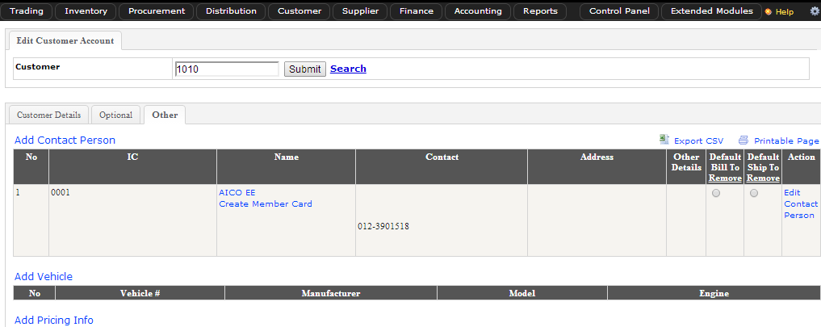
1.0 Master Data Management
1.2 Customer Master
1.2a Create New Customer
1.2b Add Customer Contact Person
1.2c Generate Customer List
Description | Screenshot
D. Click [Other] Tab E. Click [Add Contact Person] NB: There is no limitation of number of contact person(s) per customer account
D
E

Slide 28
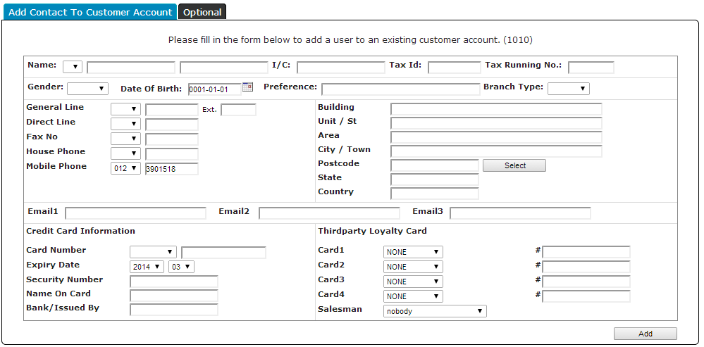
1.0 Master Data Management
1.2 Customer Master
1.2a Create New Customer
1.2b Add Customer Contact Person
1.2c Generate Customer List
Description | Screenshot
F. Add in necessary details: Name Address Contact Number Email G. Click [Add] to submit
F
G

Slide 29
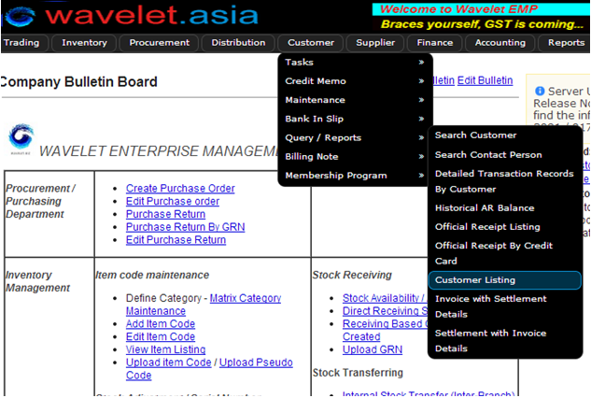
1.0 Master Data Management
1.2 Customer Master
1.2a Create New Customer
1.2b Add Customer Contact Person
1.2c Generate Customer List
Description | Screenshot
1.2c Generate Customer List Generate list of customers. A. Go to [Customer> Query/Reports> Customer Listing]
A

Slide 30
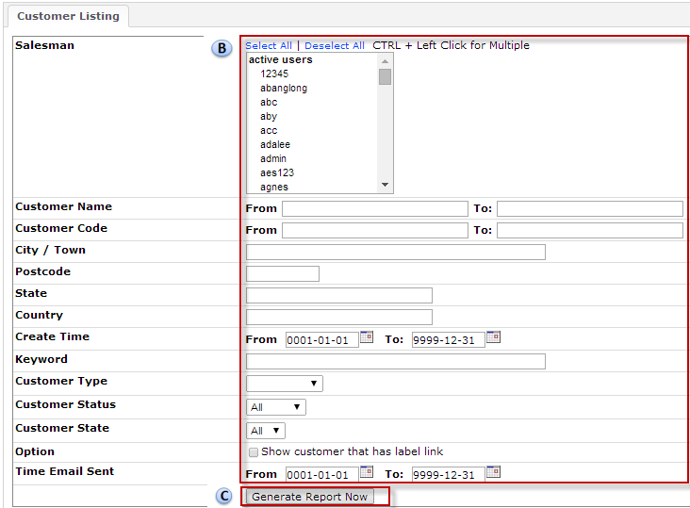
1.0 Master Data Management
1.2 Customer Master
1.2a Create New Customer
1.2b Add Customer Contact Person
1.2c Generate Customer List
Description | Screenshot
B. Use Fields to filter Customer list report C. Click [Generate Report Now]
B
B
C

Slide 31
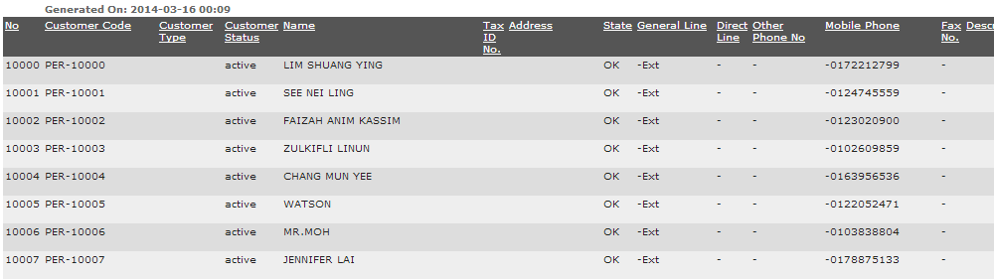
1.0 Master Data Management
1.2 Customer Master
1.2a Create New Customer
1.2b Add Customer Contact Person
1.2c Generate Customer List
Description | Screenshot
D. Example of customer list result
D

Slide 32
1.0 Master Data Management
1.1 Organization Master
1.2 Customer Master
1.3 Item Master
1.3a Create New Item
1.3b Generate Item List
1.4 Supplier Master
1.5 User Master

Slide 33
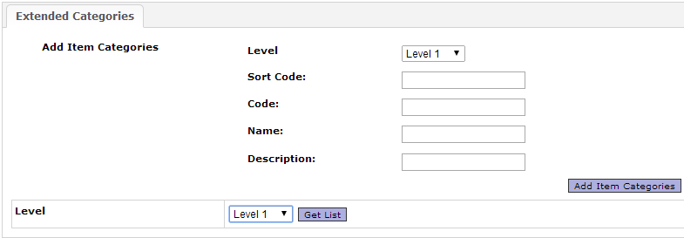
1.0 Master Data Management
1.3 Item Master
1.3a Create New Item
1.3b Generate Item List
Description | Screenshot
Matrix Category Maintenance for 1.3a-a Go to [Inventory >Item > Item Category > Item Category Maintenance]

Slide 34
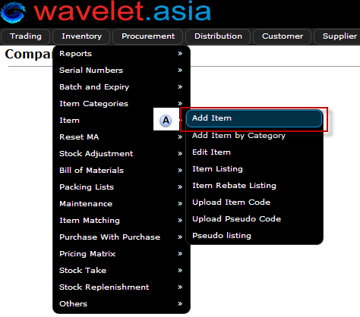
1.0 Master Data Management
1.3 Item Master
1.3a Create New Item
1.3b Generate Item List
Description | Screenshot
1.3a Create New Item Adding a new customer account A. Go to [Inventory >Item >Add Item]
A

Slide 35
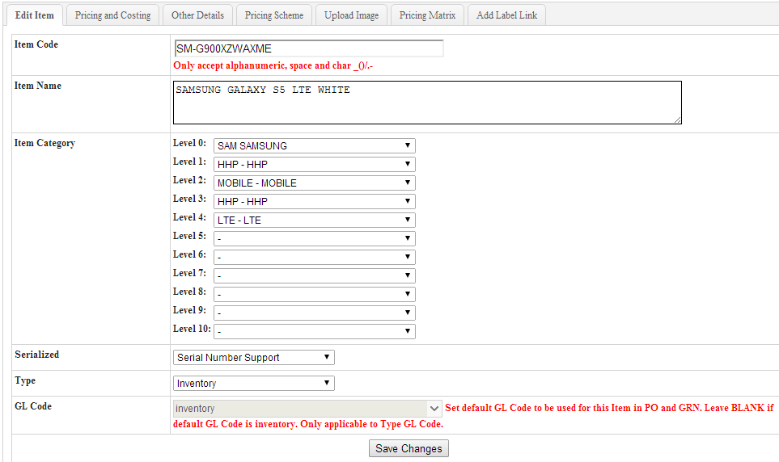
1.0 Master Data Management
1.3 Item Master
1.3a Create New Item
1.3b Generate Item List
Description | Screenshot
[Edit Item] tab B. Fill in Item Details Examples: Item Code: SM-G900XZWAXME Item Name: SAMSUNG GALAXY S5 LTE WHITE Item Category: select from dropdown list (Refer to Matrix Category) Serialized: Serialized or Non-Serialized Type: Inventory (default)
B

Slide 36
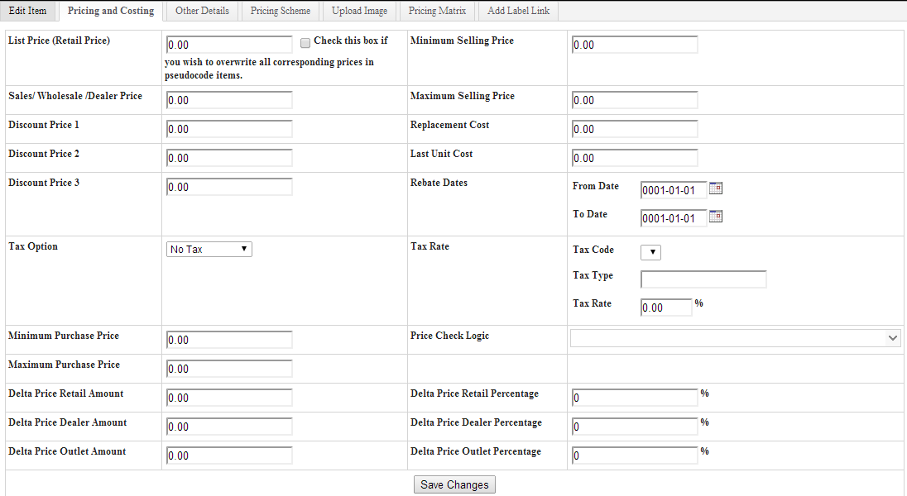
1.0 Master Data Management
1.3 Item Master
1.3a Create New Item
1.3b Generate Item List
Description | Screenshot
C. Click [Pricing and Costing] tab D. Fill in Item Pricing- 5 levels of different pricing schemes can be set E. Set Min/Max Purchase Price (if applicable) F. Set Min/Max Selling Price (if applicable)
C
D
F
E

Slide 37
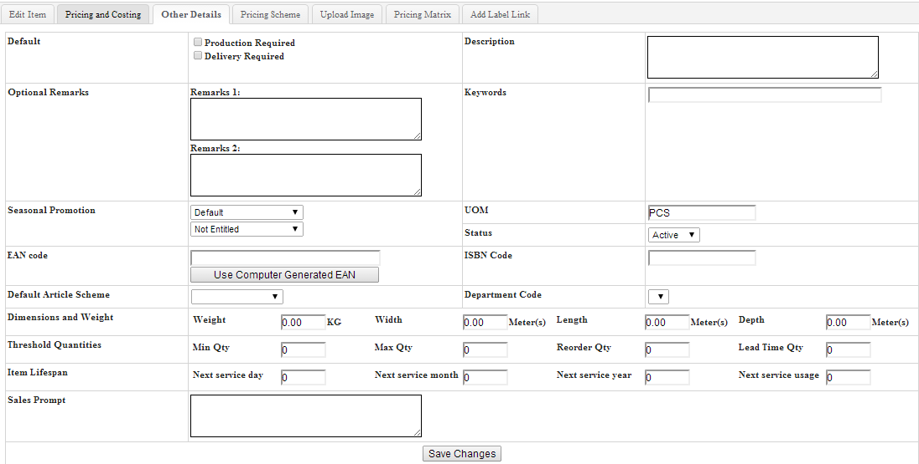
1.0 Master Data Management
1.3 Item Master
1.3a Create New Item
1.3b Generate Item List
Description | Screenshot
G. Click [Other Details] tab H. Input product remarks (optional) I. Input product description J. Unit of Measure (UOM): e.g. Pcs, Units K. Click [Save Changes] to submit
G
I
H
J
K

Slide 38
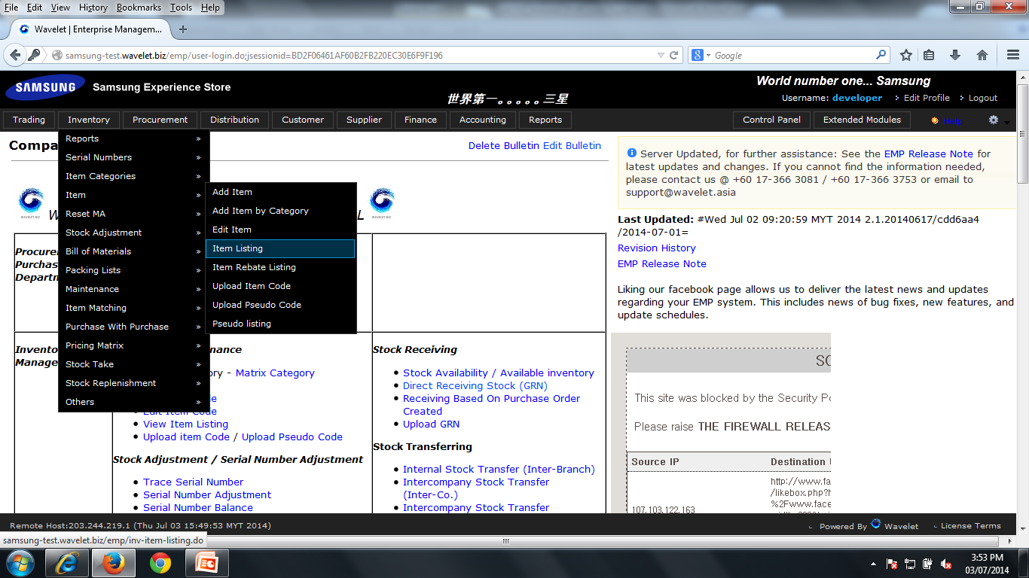
1.0 Master Data Management
1.3 Item Master
1.3a Create New Item
1.3b Generate Item List
Description | Screenshot
1.3b Generate Item List To list out items on system A. Go to [Inventory >Item >Item Listing]
A

Slide 39
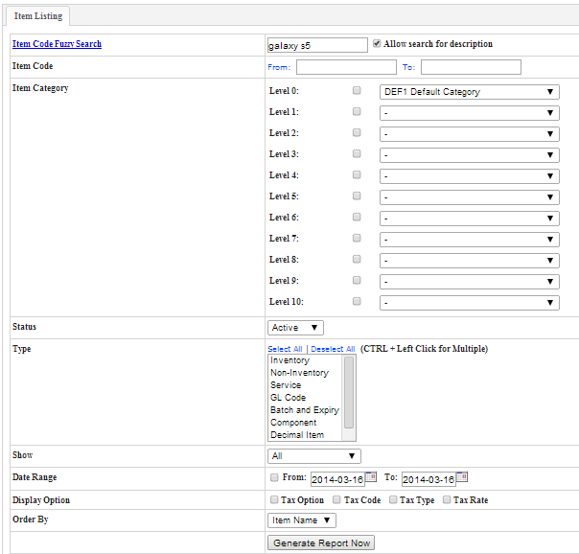
1.0 Master Data Management
1.3 Item Master
1.3a Create New Item
1.3b Generate Item List
Description | Screenshot
B. Use filters to search for items Examples: Item Code Fuzzy Search: type in partial/full model code/description Item Code: From 0001 to 1000 Item Category Status: Active/Inactive/Deleted Type: Select All Date Range Order by: Item name/ code C. Click [Generate Report Now]
B
A
C

Slide 40
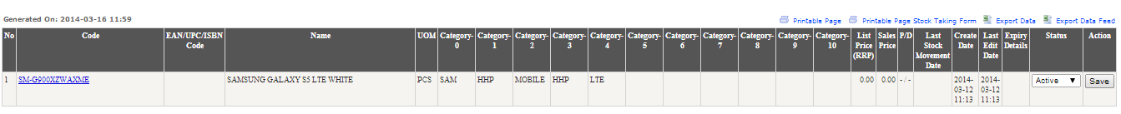
1.0 Master Data Management
1.3 Item Master
1.3a Create New Item
1.3b Generate Item List
Description | Screenshot
Result Page C. Click Item Code in blue to go to edit item page.
C

Slide 41
1.0 Master Data Management
1.1 Organization Master
1.2 Customer Master
1.3 Item Master
1.4 Supplier Master
1.4a Create New Supplier
1.4b Generate Supplier List
1.5 User Master

Slide 42
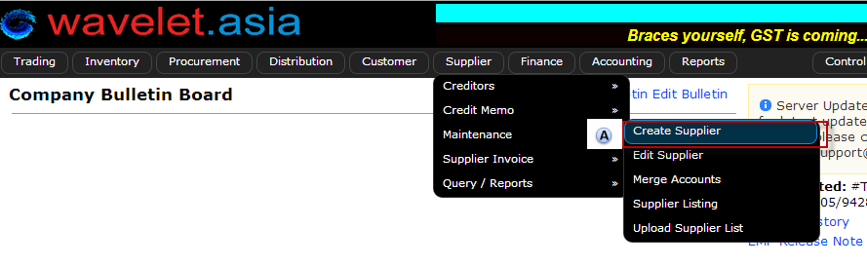
1.0 Master Data Management
1.4 Supplier Master
1.4a Create New Supplier
1.4b Generate Supplier List
Description | Screenshot
1.4a Create New Supplier Adding a new customer account A. Go to [Supplier> Maintenance> Create Supplier]

Slide 43
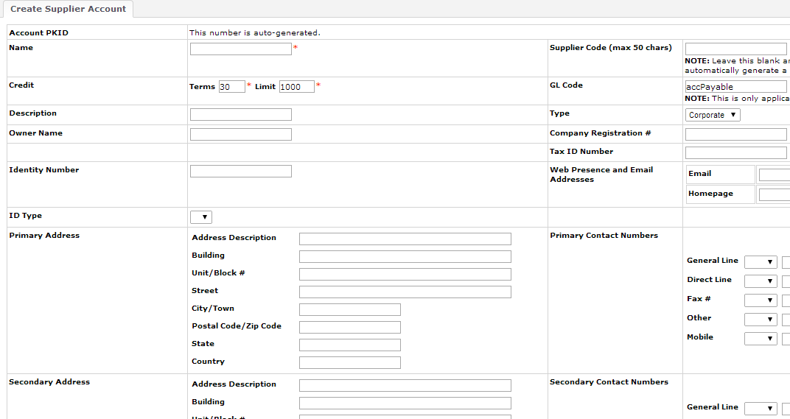
1.0 Master Data Management
1.4 Supplier Master
1.4a Create New Supplier
1.4b Generate Supplier List
Description | Screenshot
B. Fill in compulsory fields: Example Supplier Name Credit Terms: Days and Amount (RM) Address GL Code: Only applicable to Non-Trade Suppliers-assign GL Code here Type: Personal/Corporate
B
B
B

Slide 44
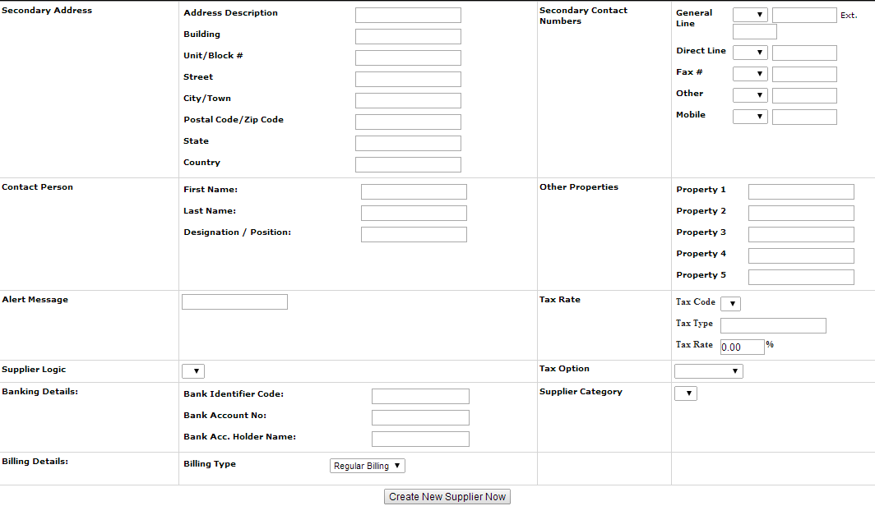
1.0 Master Data Management
1.4 Supplier Master
1.4a Create New Supplier
1.4b Generate Supplier List
Description | Screenshot
Fill in compulsory fields: Example Contact Person C. Click [Create New Supplier Now] to submit
C

Slide 45
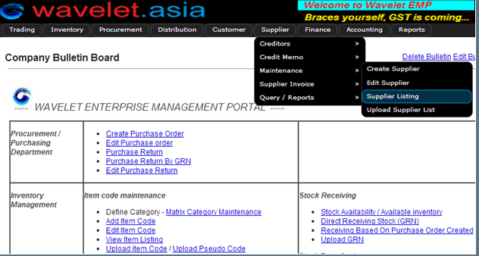
1.0 Master Data Management
1.4 Supplier Master
1.4a Create New Supplier
1.4b Generate Supplier List
Description | Screenshot
1.4a Generate Supplier List To list out suppliers on system A. Go to [Supplier> Maintenance> Supplier Listing]
A

Slide 46
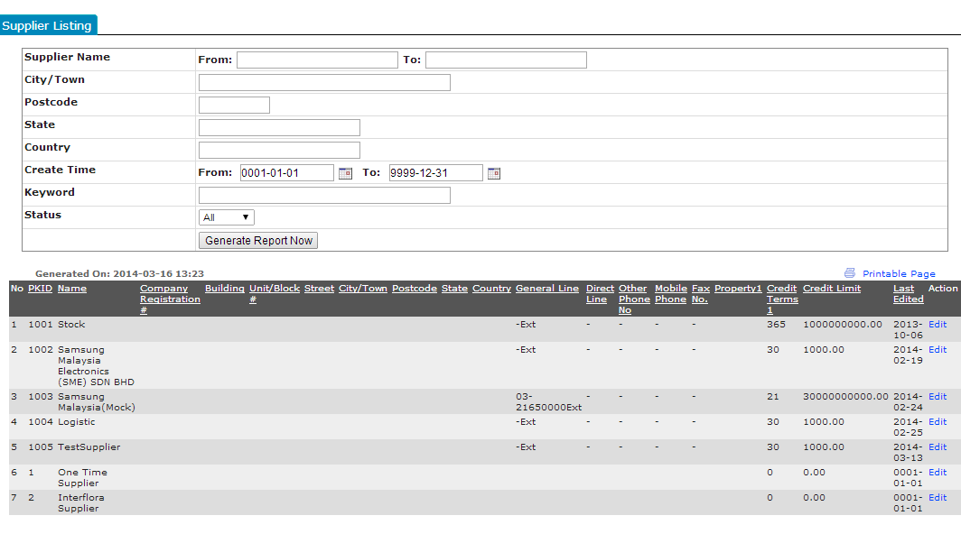
1.0 Master Data Management
1.4 Supplier Master
1.4a Create New Supplier
1.4b Generate Supplier List
Description | Screenshot
B. Apply filters to search suppliers C. Click [Generate Report Now] D. Results E. Click [Edit] in blue to go to edit supplier page.
B
C
D
E

Slide 47
1.0 Master Data Management
1.1 Organization Master
1.2 Customer Master
1.3 Item Master
1.4 Supplier Master
1.5 User Master
1.5a Create New User
1.5b Create New Role
1.5c Edit Role
1.5d Generate User List
1.5e Configure Role Permissions

Slide 48
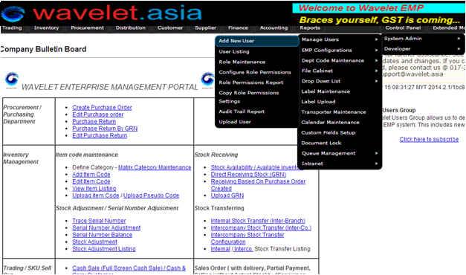
1.0 Master Data Management
1.5 User Master
1.5a Create New User
1.5b Create New Role
1.5c Edit Role
1.5d Generate User List
1.5e Config. Role Permissions
Description | Screenshot
1.5a Create New User Go to [Control Panel >System Admin> Manage User>Add new user]
A

Slide 49
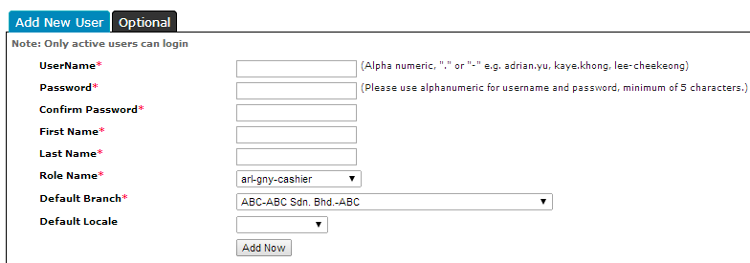
1.0 Master Data Management
1.5 User Master
1.5a Create New User
1.5b Create New Role
1.5c Edit Role
1.5d Generate User List
1.5e Config. Role Permissions
Description | Screenshot
B. Fill in compulsory fields: User Name: used for EMP log-in Password: used for EMP log-in First Name Last Name Role Name: to create in #1.5b Default Branch: default store location C. Click [Add Now] to submit
B
C

Slide 50
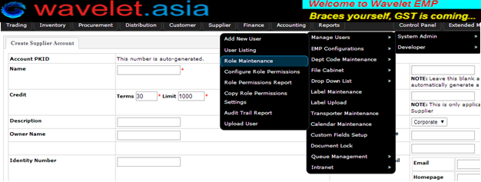
1.0 Master Data Management
1.5 User Master
1.5a Create New User
1.5b Create New Role
1.5c Edit Role
1.5d Generate User List
1.5e Config. Role Permissions
Description | Screenshot
1.5b Create New Role A. Go to [Control Panel>System Admin >Manage User >Role Maintenance]
A

Slide 51
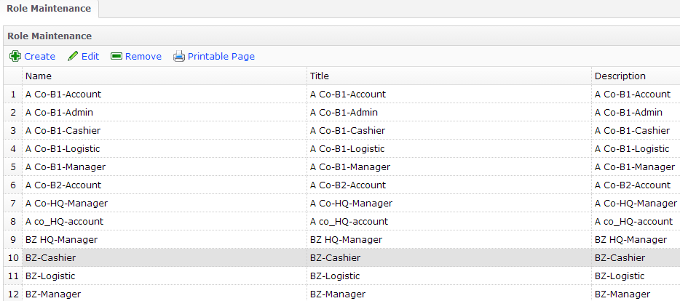
1.0 Master Data Management
1.5 User Master
1.5a Create New User
1.5b Create New Role
1.5c Edit Role
1.5d Generate User List
1.5e Config. Role Permissions
Description | Screenshot
B. Role List Existing role permissions
B

Slide 52
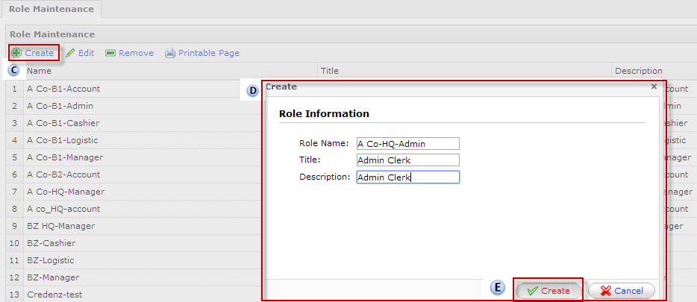
1.0 Master Data Management
1.5 User Master
1.5a Create New User
1.5b Create New Role
1.5c Edit Role
1.5d Generate User List
1.5e Config. Role Permissions
Description | Screenshot
C. Click [Create] to add new role D. On pop-up box, fill in details: Role Name Title Description E. Click [Create] to submit
D
E

Slide 53
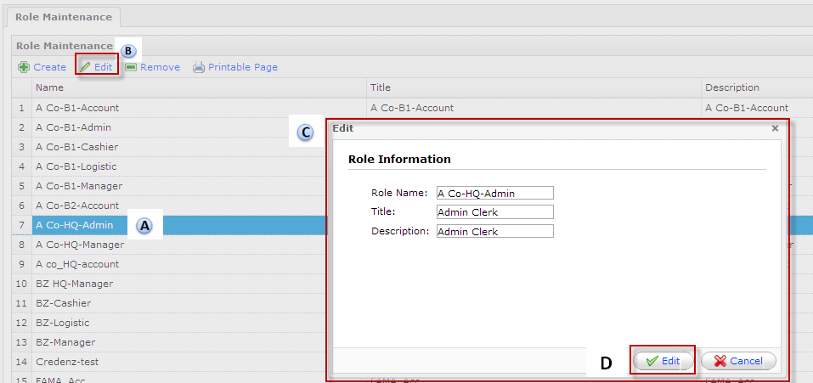
1.0 Master Data Management
1.5 User Master
1.5a Create New User
1.5b Create New Role
1.5c Edit Role
1.5d Generate User List
1.5e Config. Role Permissions
Description | Screenshot
1.5c Edit Role Make changes to details of existing roles Highlight role to be edited Click [Edit] On pop-up box, update details Click [Edit] to submit changes
B
C
D

Slide 54
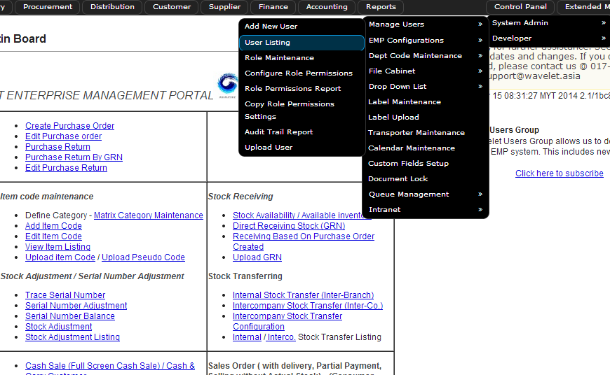
1.0 Master Data Management
1.5 User Master
1.5a Create New User
1.5b Create New Role
1.5c Edit Role
1.5d Generate User List
1.5e Config. Role Permissions
Description | Screenshot
1.5d Generate User List Go to [Control Panel >System Admin> Manage User>User Listing]
A

Slide 55
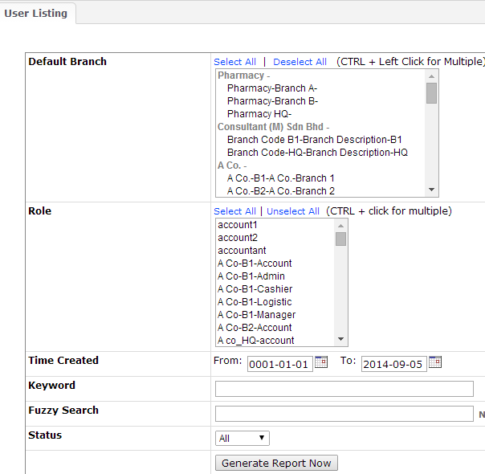
1.0 Master Data Management
1.5 User Master
1.5a Create New User
1.5b Create New Role
1.5c Edit Role
1.5d Generate User List
1.5e Config. Role Permissions
Description | Screenshot
B. Use Default Branch and Role filter C. Click [Generate Report Now]
B
C

Slide 56
1.0 Master Data Management
1.5 User Master
1.5a Create New User
1.5b Create New Role
1.5c Edit Role
1.5d Generate User List
1.5e Config. Role Permissions
Description | Screenshot
D. Results generated E. Click [Edit] to manage user details.
D

Slide 57
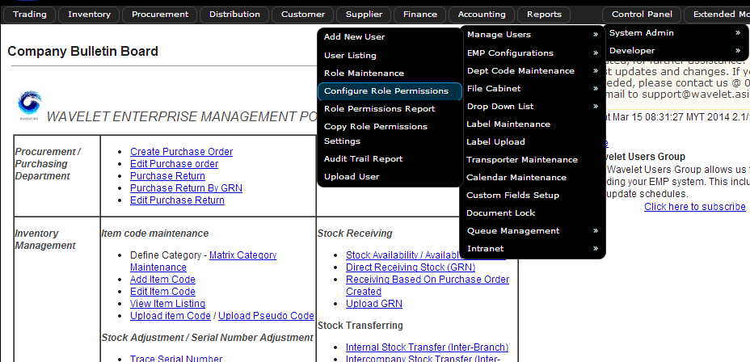
1.0 Master Data Management
1.5 User Master
1.5a Create New User
1.5b Create New Role
1.5c Edit Role
1.5d Generate User List
1.5e Config. Role Permissions
Description | Screenshot
1.5e Configure Role Permissions Set user access to modules and functions A. Go to [Control Panel >System Admin> Manage User>Configure role permission]
A

Slide 58
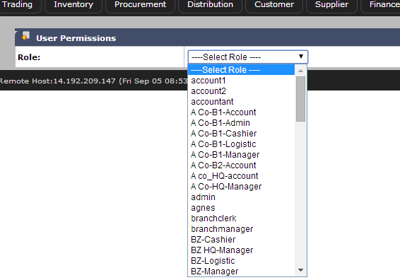
1.0 Master Data Management
1.5 User Master
1.5a Create New User
1.5b Create New Role
1.5c Edit Role
1.5d Generate User List
1.5e Config. Role Permissions
Description | Screenshot
B. Select role to be configured
B

Slide 59
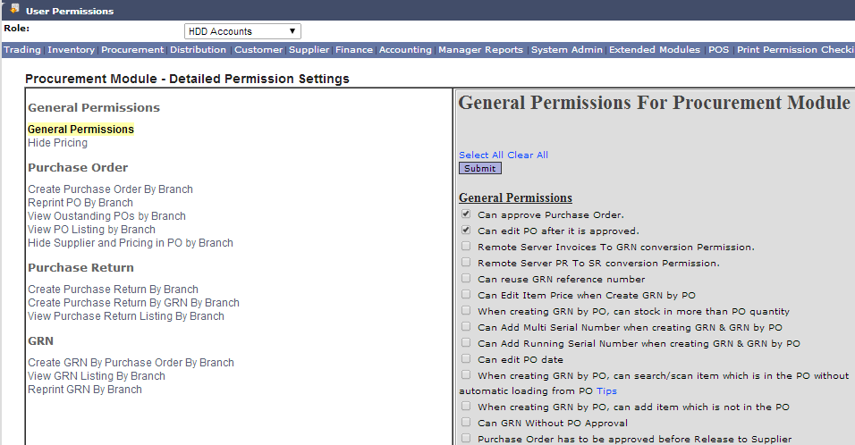
1.0 Master Data Management
1.5 User Master
1.5a Create New User
1.5b Create New Role
1.5c Edit Role
1.5d Generate User List
1.5e Config. Role Permissions
Description | Screenshot
C. Select Module to set permission E.g. Procurement Module is selected D. General Permissions configures user of role access to selected modules and functions E. [TICK] to select access F. Click [Submit] to complete changes
C
D
F
E

Slide 60
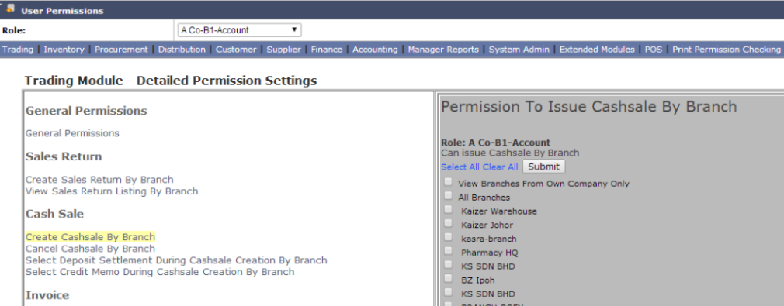
1.0 Master Data Management
1.5 User Master
1.5a Create New User
1.5b Create New Role
1.5c Edit Role
1.5d Generate User List
1.5e Config. Role Permissions
Description | Screenshot
G. Permission may also be set to specific branches
G

Slide 61

2.0 Sales Order Management
2.1 Create Sales Order
2.2 Scan IMEI into Sales Order
2.3 Convert Sales Order to Invoice
2.4 Sales Return by Invoice

Slide 62

2.0 Sales Order Management
2.1 Create Sales Order
Description | Screenshot
2.1 Create Sales Order Go to [Distribution > Order Taking > Create Sales Order]
A

Slide 63

2.0 Sales Order Management
2.1 Create Sales Order
Description | Screenshot
B. Use drop down list to select sales branch and click [Change] C. Option 1: Key in Customer code and click [Submit] Option 2: Click [Customer] to search by Customer Name D. Click [Account Details] to expand box below E. Select [Ship to] address from drop down list (Set as Branch in User Guide#x) and click [Submit]
B
C
D
E

Slide 64
2.0 Sales Order Management
2.1 Create Sales Order
Description | Screenshot
F. Use drop down list to select sales person G. Reference: input customer PO number H. Click ]Submit]
F
G
H

Slide 65


2.0 Sales Order Management
2.1 Create Sales Order
Description | Screenshot
To input Request Delivery Date I. Click on [Delivery Details] tab J. Select delivery date K. Click [Save Delivery Details]
I
J
K

Slide 66

2.0 Sales Order Management
2.1 Create Sales Order
Description | Screenshot
Back to [New Sales Order] Tab L. Input: item code/description and click [Submit]
L

Slide 67


2.0 Sales Order Management
2.1 Create Sales Order
Description | Screenshot
J. Click on the selected model code
J

Slide 68

2.0 Sales Order Management
2.1 Create Sales Order
Description | Screenshot
K. Input the following: Quantity Selling price L. Click [Submit]
K
L

Slide 69

2.0 Sales Order Management
2.1 Create Sales Order
Description | Screenshot
The items selected will appear here on the Sales Order. Grey= available stock balance Blue= no stock from this branch Pink= selling price below cost M. Click Create Sales Order to complete
M

Slide 70

2.0 Sales Order Management
2.1 Create Sales Order
Description | Screenshot
Sales Order will pop-up for printing.

Slide 71
2.0 Sales Order Management
2.1 Create Sales Order
2.2 Scan IMEI into Sales Order
2.3 Convert Sales Order to Invoice
2.4 Sales Return by Invoice

Slide 72

2.0 Sales Order Management
2.2 Scan IMEI into Sales Order
Description | Screenshot
2.2 Scan in IMEI number into Sales Order A. Go To [Distribution> Order Taking> Misc Listing]
A

Slide 73

2.0 Sales Order Management
2.2 Scan IMEI into Sales Order
Description | Screenshot
B. Click on [General Sales Order Listing Detail]
B

Slide 74

2.0 Sales Order Management
2.2 Scan IMEI into Sales Order
Description | Screenshot
Use Filters to narrow down search C. Click [Get Listing]
C

Slide 75

2.0 Sales Order Management
2.2 Scan IMEI into Sales Order
Description | Screenshot
D. Click [Edit]
D

Slide 76

2.0 Sales Order Management
2.2 Scan IMEI into Sales Order
Description | Screenshot
E. Click [Edit]
E

Slide 77

2.0 Sales Order Management
2.2 Scan IMEI into Sales Order
Description | Screenshot
H. Click [Save Sales Order]
F

Slide 78

2.0 Sales Order Management
2.2 Scan IMEI into Sales Order
Description | Screenshot
F. Scan in IMEI numbers and click [Add] G. Click [Save Changes]
F
G

Slide 79
2.0 Sales Order Management
2.1 Create Sales Order
2.2 Scan IMEI into Sales Order
2.3 Convert Sales Order to Invoice
2.4 Sales Return by Invoice

Slide 80

2.0 Sales Order Management
2.3 Convert SO to Invoice
Description | Screenshot
2.3 Convert Sales Order to Invoice Go to [Trading> Sales>Create Invoice]
A

Slide 81

2.0 Sales Order Management
2.3 Convert SO to Invoice
Description | Screenshot
B. Select Branch and click [Change] C. Input Sales Order # and click [Submit]
B
C

Slide 82

2.0 Sales Order Management
2.3 Convert SO to Invoice
Description | Screenshot
D. Click [Create Invoice].
D

Slide 83

2.0 Sales Order Management
2.3 Convert SO to Invoice
Description | Screenshot
Invoice will pop-up for printing

Slide 84

2.0 Sales Order Management
2.3 Convert SO to Invoice
Description | Screenshot
E. Click [Print as DO] for Delivery Order Print-out
E

Slide 85
2.0 Sales Order Management
2.1 Create Sales Order
2.2 Scan IMEI into Sales Order
2.3 Convert Sales Order to Invoice
2.4 Sales Return by Invoice

Slide 86

2.0 Sales Order Management
2.4 Sales Return by Invoice
Description | Screenshot
2.4 Convert Sales Order to Invoice Go to [Trading > Sales > Sales Return by Invoice]
A

Slide 87

2.0 Sales Order Management
2.4 Sales Return by Invoice
Description | Screenshot
B. Select branch from drop down list and click [Change] C. Input Invoice number and click [Submit]’ D. Input remarks for sales return. E. Click [Set Details] to save remarks.
B
C
D
E

Slide 88

2.0 Sales Order Management
2.4 Sales Return by Invoice
Description | Screenshot
Option 1: F. [Click here to return all goods] Option 2 G. Individually tick serial numbers that are to be returned. H. Click [Submit] NB: Credit memo is automatically created and posted to AR account for contra on same/next invoice.
F
G
H

Slide 89
3.0 Purchase Order Management
3.1 Create Purchase Order
3.2 Goods Receive Note by PO
3.3 Purchase Return by Goods Receive Note

Slide 90
3.0 Purchase Order Management
3.1 Create Purchase Order
3.2 Goods Receive Note by PO
3.3 Purchase Return by Goods Receive Note

Slide 91

3.0 Purchase Order Management
3.1 Create Purchase Order
Description | Screenshot
3.1 Create Purchase Order A. Go to [Procurement> Transactions> New Purchase Order]
A

Slide 92

3.0 Purchase Order Management
3.1 Create Purchase Order
Description | Screenshot
B. Select branch from drop down list. Click [Set Branch] C. Input Supplier code/name and click [Submit] D. Input item code/name and click [Submit]
D

Slide 93

3.0 Purchase Order Management
3.1 Create Purchase Order
Description | Screenshot
E. Input the following: Quantity Purchase Price F. Click [Save Changes] to submit
F

Slide 94

3.0 Purchase Order Management
3.1 Create Purchase Order
Description | Screenshot
G. Click [Confirm and Save] to submit Purchase Order
G

Slide 95

3.0 Purchase Order Management
3.1 Create Purchase Order
Description | Screenshot
Purchase Order will pop up for printing

Slide 96
3.0 Purchase Order Management
3.1 Create Purchase Order
3.2 Goods Receive Note by PO
3.3 Purchase Return by Goods Receive Note

Slide 97

3.0 Purchase Order Management
3.2 GRN by PO
Description | Screenshot
3.2 Goods Receive Note (GRN) by Purchase Order (PO) Stock in by PO A. Go to [Procurement> Transactions >Create GRN by Purchase Order]
A

Slide 98

3.0 Purchase Order Management
3.2 GRN by PO
Description | Screenshot
Option 1 B. Click [PO Number] in blue to search for PO Option 2: C. Key in PO Number, D. Click [Submit]
B
C
D

Slide 99

3.0 Purchase Order Management
3.2 GRN by PO
Description | Screenshot
E. Input Supplier Invoice or Delivery Order Number (Compulsory) F. Option 1:Click [Auto Add All] to import entire PO if all goods are received Option 2 Click [Add Item from PO] for partial goods receipt G. Click [Edit] to input serial number
E
F
G
NB: For all serialized items, it is compulsory to stock in by scanning in individual IMEIs

Slide 100

3.0 Purchase Order Management
3.2 GRN by PO
Description | Screenshot
On Pop-up screen H. Using a barcode scanner, scan in the individual IMEI/Serial Number and press “enter” after each one. I. The list of IMEI/Serial Numbers scanned in will appear here J. Click [Add] K. Click [Save Changes] to complete insertion of IMEI/Serial Number.
H
I
J
K

Slide 101

3.0 Purchase Order Management
3.2 GRN by PO
Description | Screenshot
L. Click [Confirm and Save] to complete stock in.
L

Slide 102

3.0 Purchase Order Management
3.2 GRN by PO
Description | Screenshot
GRN pop-up will appear for printing

Slide 103
3.0 Purchase Order Management
3.1 Create Purchase Order
3.2 Goods Receive Note by PO
3.3 Purchase Return by Goods Receive Note

Slide 104

3.0 Purchase Order Management
3.3 Purchase Return by GRN
Description | Screenshot
3.2 Purchase Return by Goods Receive Note (GRN) A. Go to [Procurement> Transactions >Purchase Return by GRN]
A

Slide 105

3.0 Purchase Order Management
3.3 Purchase Return by GRN
Description | Screenshot
B. Option 1 Input GRN number in box and click submit Option 2 Click [Purchase Return Listing] to search for GRN
B

Slide 106


3.0 Purchase Order Management
3.3 Purchase Return by GRN
Description | Screenshot
C. Option 1 Return all items on GRN D. Option 2 Partial return For Serialized Items Tick IMEI/Serial number to be returned For Non-serialized items Input Qty E. Click [Submit] F. Click [Confirm and Save]
F
C
D
E

Slide 107

3.0 Purchase Order Management
3.3 Purchase Return by GRN
Description | Screenshot
GRN pop-up will appear for printing

Slide 108
4.0 Inventory Management
4.1 Create Stock Requisition
4.2 Create Stock Transfer
4.3 Create Stock Adjustment

Slide 109
4.0 Inventory Management
4.1 Create Stock Requisition
4.2 Create Stock Transfer
4.3 Create Stock Adjustment

Slide 110

4.0 Inventory Management
4.1 Create Stock Requisition
Description | Screenshot
4.1 Create Stock Requisition Request for stock from other branches A. Go to [Trading> Stock Requisition> Stock Requisition Create]
A

Slide 111

4.0 Inventory Management
4.1 Create Stock Requisition
Description | Screenshot
B. Using drop down list, select From and To Branch C. Click [Save Details] D. Input Item Code or Product Description
B
Optional
C
D

Slide 112

4.0 Inventory Management
4.1 Create Stock Requisition
Description | Screenshot
E. Input Qty F. Click [Save Changes] to submit
E
F

Slide 113

4.0 Inventory Management
4.1 Create Stock Requisition
Description | Screenshot
G. Click [Save] to complete stock requisition

Slide 114
4.0 Inventory Management
4.1 Create Stock Requisition
4.2 Create Internal Stock Transfer
4.2a Create Internal Stock Transfer
4.2b Generate Stock Transfer Listing
4.2c Generate Detailed Stock Transfer List
4.2d Receive Stock Transfer
4.2 e Cancel Stock Transfer
4.3 Create Stock Adjustment

Slide 115

4.0 Inventory Management
4.2 Internal Stock Transfer
4.2a Create Stock Transfer
4.2b Generate stock transfer list
4.2c Generate Stock Transfer List (Detailed)
4.2d Receive Stock Transfer
4.2e Cancel Stock Transfer
Description | Screenshot
4.2a Create Internal Stock Transfer A. Go to [Trading> Internal Stock Transfer> Create]
A

Slide 116

4.0 Inventory Management
4.2 Internal Stock Transfer
4.2a Create Stock Transfer
4.2b Generate stock transfer list
4.2c Generate Stock Transfer List (Detailed)
4.2d Receive Stock Transfer
4.2e Cancel Stock Transfer
Description | Screenshot
B. Select From and To Branch for stock transfer C. Fill in the compulsory details of stock transfer Transporter name (select from dropdown list) Reference number Senders Remarks D. There are various method of stock transfer listed Item Serial Number Stock Requisition # GRN
B
C
D

Slide 117


4.0 Inventory Management
4.2 Internal Stock Transfer
4.2a Create Stock Transfer
4.2b Generate stock transfer list
4.2c Generate Stock Transfer List (Detailed)
4.2d Receive Stock Transfer
4.2e Cancel Stock Transfer
Description | Screenshot
Method 1 - Item E. Input item code or name and click [Submit] In Pop-up box F. Holding Ctrl button, multi select the IMEI/Serial Numbers to of units to be Transferred G. Click [Confirm and Close]
E
G
F
G

Slide 118
4.0 Inventory Management
4.2 Internal Stock Transfer
4.2a Create Stock Transfer
4.2b Generate stock transfer list
4.2c Generate Stock Transfer List (Detailed)
4.2d Receive Stock Transfer
4.2e Cancel Stock Transfer
Description | Screenshot
Method 2 – Serial Numer H. Input serial number and click [Submit] In Pop-up box I. Input the same serial number J. Click [Confirm and Close] K. Click [Confirm and Close]
H
K
I
J

Slide 119

4.0 Inventory Management
4.2 Internal Stock Transfer
4.2a Create Stock Transfer
4.2b Generate stock transfer list
4.2c Generate Stock Transfer List (Detailed)
4.2d Receive Stock Transfer
4.2e Cancel Stock Transfer
Description | Screenshot
Method 3 – Stock Requisition Number L. Option 1 Input stock requisition number and click [Submit] Option2 Click [Stock Requisition #] in blue to search M. Select date range for stock requisitions and click [Submit] N. Input qty for stock transfer O. Click [Submit]
L
M
O
N

Slide 120

4.0 Inventory Management
4.2 Internal Stock Transfer
4.2a Create Stock Transfer
4.2b Generate stock transfer list
4.2c Generate Stock Transfer List (Detailed)
4.2d Receive Stock Transfer
4.2e Cancel Stock Transfer
Description | Screenshot
Method 3 – GRN # P. Input GRN# and Click [Submit] Q. Click Confirm and Save to complete stock transfer
P
Q

Slide 121

4.0 Inventory Management
4.2 Internal Stock Transfer
4.2a Create Stock Transfer
4.2b Generate stock transfer list
4.2c Generate Stock Transfer List (Detailed)
4.2d Receive Stock Transfer
4.2e Cancel Stock Transfer
Description | Screenshot
4.2b Generate internal stock transfer list A. Go to [Trading> Internal Stock Transfer> Listing]
A

Slide 122

4.0 Inventory Management
4.2 Internal Stock Transfer
4.2a Create Stock Transfer
4.2b Generate stock transfer list
4.2c Generate Stock Transfer List (Detailed)
4.2d Receive Stock Transfer
4.2e Cancel Stock Transfer
Description | Screenshot
B. Use Filters to specify list to be generated C. Click [Generate Report Now]
B
C

Slide 123

4.0 Inventory Management
4.2 Internal Stock Transfer
4.2a Create Stock Transfer
4.2b Generate stock transfer list
4.2c Generate Stock Transfer List (Detailed)
4.2d Receive Stock Transfer
4.2e Cancel Stock Transfer
Description | Screenshot
Example of stock transfer list generated

Slide 124

4.0 Inventory Management
4.2 Internal Stock Transfer
4.2a Create Stock Transfer
4.2b Generate stock transfer list
4.2c Generate Stock Transfer List (Detailed)
4.2d Receive Stock Transfer
4.2e Cancel Stock Transfer
Description | Screenshot
4.2c Generate internal stock transfer list (Detailed) More details are listed out: Item Name, Serial Number, and Transporter name A. Go to [Trading> Internal Stock Transfer> Details Listing]
A

Slide 125

4.0 Inventory Management
4.2 Internal Stock Transfer
4.2a Create Stock Transfer
4.2b Generate stock transfer list
4.2c Generate Stock Transfer List (Detailed)
4.2d Receive Stock Transfer
4.2e Cancel Stock Transfer
Description | Screenshot
B. Use Filters to specify list to be generated C. Click [Generate Report Now]
B
C

Slide 126

4.0 Inventory Management
4.2 Internal Stock Transfer
4.2a Create Stock Transfer
4.2b Generate stock transfer list
4.2c Generate Stock Transfer List (Detailed)
4.2d Receive Stock Transfer
4.2e Cancel Stock Transfer
Description | Screenshot
Example of detailed stock transfer list generated

Slide 127

4.0 Inventory Management
4.2 Internal Stock Transfer
4.2a Create Stock Transfer
4.2b Generate stock transfer list
4.2c Generate Stock Transfer List (Detailed)
4.2d Receive Stock Transfer
4.2e Cancel Stock Transfer
Description | Screenshot
4.2d Receive stock transfer A. Go to [Trading> Internal Stock Transfer> Receive]
A

Slide 128


4.0 Inventory Management
4.2 Internal Stock Transfer
4.2a Create Stock Transfer
4.2b Generate stock transfer list
4.2c Generate Stock Transfer List (Detailed)
4.2 Receive Stock Transfer
4.2e Cancel Stock Transfer
Description | Screenshot
B. Input Stock Transfer Number and click [Submit] C. Click [YES, I CONFIRM I HAVE RECEIVED THE STOCK ABOVE] to complete stock receive.
B
C

Slide 129

4.0 Inventory Management
4.2 Internal Stock Transfer
4.2a Create Stock Transfer
4.2b Generate stock transfer list
4.2c Generate Stock Transfer List (Detailed)
4.2d Receive Stock Transfer
4.2e Cancel Stock Transfer
Description | Screenshot
4.2e Cancel stock transfer A. Go to [Trading> Internal Stock Transfer> Cancel]
A

Slide 130


4.0 Inventory Management
4.2 Internal Stock Transfer
4.2a Create Stock Transfer
4.2b Generate stock transfer list
4.2c Generate Stock Transfer List (Detailed)
4.2d Receive Stock Transfer
4.2e Cancel Stock Transfer
Description | Screenshot
B. Input Stock Transfer Number and click [Submit] C. Click [Cancel Stock Transfer] to complete cancellation
B
B

Slide 131
4.0 Inventory Management
4.1 Create Stock Requisition
4.2 Create Stock Transfer
4.3 Create Stock Adjustment

Slide 132

4.0 Inventory Management
4.3 Stock Adjustment
Description | Screenshot
4.3 Stock Adjustment To increase or decrease the quantity of stock A. Go to [Inventory> Stock Adjustment> Stock Adjustment]
A

Slide 133

4.0 Inventory Management
4.3 Stock Adjustment
Description | Screenshot
B. Select branch to be adjusted C. Input model code or name and click [Select Item Code] D. Click [Select] E. To Add quantity Qty mode [+] Input Qty Input Supplier code or click [Supplier] to search Scan Serial Number to be added. Click [Add Item]
B
C
D
E

Slide 134


4.0 Inventory Management
4.3 Stock Adjustment
Description | Screenshot
F. To reduce quantity Qty mode [-] Input Qty Scan Serial Number to be removed Click [Add Item] G. Click [Confirm and Save] to complete stock adjustment
F
F

Slide 135
5.0 Finance
5.1 Customer Aging
5.1a Monitor Customer Outstanding Invoices
5.1b Print Customer Statement of Account
5.2 Account Receivable
5.3 Account Payable

Slide 136

5.0 Finance
5.1 Customer Aging
5.1a Monitor Customer Outstanding Invoice
5.1b Print Customer Statement Of Account
Description | Screenshot
5.1a Monitor Customer Outstanding Invoices Go to [Customer> Tasks> Monitor Outstanding Document]
A

Slide 137

5.0 Finance
5.1 Customer Aging
5.1a Monitor Customer Outstanding Invoice
5.1b Print Customer Statement Of Account
Description | Screenshot
B. Use filters available to narrow down report search Customer: Input customer code in blank box or click [Select] to search by customer name Branch: single or multiple Salesman: search by default salesman for customer (set in 1.2a-e) C. Click [Generate Report Now!]
B
C

Slide 138

5.0 Finance
5.1 Customer Aging
5.1a Monitor Customer Outstanding Invoice
5.1b Print Customer Statement Of Account
Description | Screenshot
Example of Outstanding Customer Documents Red: Payment Overdue Blue: Payment Not Overdue D. Click here to obtain document details. INV: Invoice CM: Credit Memo (outstanding credit memo not contrasted with invoices RCT: Receipt Voucher (when partial deposit is made)
D

Slide 139

5.0 Finance
5.1 Customer Aging
5.1a Monitor Customer Outstanding Invoice
5.1b Print Customer Statement Of Account
Description | Screenshot
5.1b Print Customer Statement of Account Go to [Customer> Tasks> Statement of Account]
A

Slide 140

5.0 Finance
5.1 Customer Aging
5.1a Monitor Customer Outstanding Invoice
5.1b Print Customer Statement Of Account
Description | Screenshot
B. Input Customer Code or click [Select] to search customer by name C. Select Branch D. Select month of statement E. Click [Generate Statement]
B
C
D
E

Slide 141

5.0 Finance
5.1 Customer Aging
5.1a Monitor Customer Outstanding Invoice
5.1b Print Customer Statement Of Account
Description | Screenshot
F. Click [Print to PDF] to print out hard copy or save as PDF for email use.
F

Slide 142
5.0 Finance
5.1 Customer Aging
5.2 Account Receivable
5.2a Receive Customer Payment
5.3 Account Payable

Slide 143

5.0 Finance
5.2 Account Receivable
5.2a Receive Customer Payment
Description | Screenshot
5.2a Receive Customer Payment Receive partial/full payment made by customer A. Go to [Customer> Tasks> Settle Document/Deposit]
A

Slide 144

5.0 Finance
5.2 Account Receivable
5.2a Receive Customer Payment
Description | Screenshot
[Settlement/Collection ] tab B. Select Branch receiving payment from dropdown list and click [Change] C. Input customer code or click [Customer] to search by name, and click [Submit]. D. Input Remarks (optional) E. Click [Submit]
B
C
D
E

Slide 145

5.0 Finance
5.2 Account Receivable
5.2a Receive Customer Payment
Description | Screenshot
[Payment Details] tab F. Input payment details Cash Credit Card Cheque Open Credit/Deposit G. Click [Recalculate]
F
G

Slide 146

5.0 Finance
5.2 Account Receivable
5.2a Receive Customer Payment
Description | Screenshot
[Invoice Listing] Tab H. Tick box for which Invoice to settle, or type in box amount to paid. I. Click [Submit Settlement] J. Click [Confirm and Save] to complete settlement.
H
I
J

Slide 147
5.0 Finance
5.1 Customer Aging
5.2 Account Receivable
5.3 Account Payable
5.3a Monitor Supplier Outstanding Invoice
5.3b Issue Payment to Supplier

Slide 148

5.0 Finance
5.3 Account Payable
5.3a Monitor Supplier Outstanding Invoice
5.3b Issue Payment to Supplier
Description | Screenshot
5.3a Monitor Supplier Outstanding Invoice A. Go to [Supplier> Creditors> Monitor Outstanding Invoice]
A

Slide 149

5.0 Finance
5.3 Account Payable
5.3a Monitor Supplier Outstanding Invoice
5.3b Issue Payment to Supplier
Description | Screenshot
B. Input Supplier code or click [Select] to search by name C. Select branch by dropdown list D. Click [Generate Report Now]
B
C
D

Slide 150

5.0 Finance
5.3 Account Payable
5.3a Monitor Supplier Outstanding Invoice
5.3b Issue Payment to Supplier
Description | Screenshot
Example of results page

Slide 151

5.0 Finance
5.3 Account Payable
5.3a Monitor Supplier Outstanding Invoice
5.3b Issue Payment to Supplier
Description | Screenshot
5.3b Issue Payment To Supplier A. Go to [Finance> Payment Voucher> Create]
A

Slide 152

5.0 Finance
5.3 Account Payable
5.3a Monitor Supplier Outstanding Invoice
5.3b Issue Payment to Supplier
Description | Screenshot
B. Select branch making payment from drop down list and click [Change] C. Select cashbook from dropdown list and click [Submit] D. Input supplier ID or input name to search. Click [Select] E. Input Payment details: Cheque Number/TT Number Payment Remarks F. Click [Save Details]
B
C
D
E
F

Slide 153

5.0 Finance
5.3 Account Payable
5.3a Monitor Supplier Outstanding Invoice
5.3b Issue Payment to Supplier
Description | Screenshot
G. On Settle Supplier Invoice[Here]
G

Slide 154

5.0 Finance
5.3 Account Payable
5.3a Monitor Supplier Outstanding Invoice
5.3b Issue Payment to Supplier
Description | Screenshot
H. Input payment amount I. Input amount by invoice or tick box J. Click [Submit Settlement]
H
I
J

Slide 155

5.0 Finance
5.3 Account Payable
5.3a Monitor Supplier Outstanding Invoice
5.3b Issue Payment to Supplier
Description | Screenshot
K. Click [Confirm and Save]
K

Slide 156

5.0 Finance
5.3 Account Payable
5.3a Monitor Supplier Outstanding Invoice
5.3b Issue Payment to Supplier
Description | Screenshot
K. Click [Confirm and Save]
L

